Slide 1
DATS 6401 Visualization Individual Project
Analysis of Military, Health and Education Spending
Srilatha Lakka

Slide 2
Overview
Data Source – World Bank
Picked G-20 countries
Selected top ten countries in respective fields like Healthcare, Education & Military spending
Collected data ranging from (2010 to 2015)
Google API – Google docs
Various charts used – Column charts, Geo Maps, stacked bar, Bar charts, Scatter charts, Trend, lines and Pie charts
Conclusion

Slide 3
Educational spending trend
The following chart shows the trend of educational spending in USA seems to be increased from 2010 to 2013.
Decreased about 11 billions in 2014, but then raised back in 2015 to 975 billions.
Overall Mexico seems to the least spending country among the 10 countries.

Slide 4
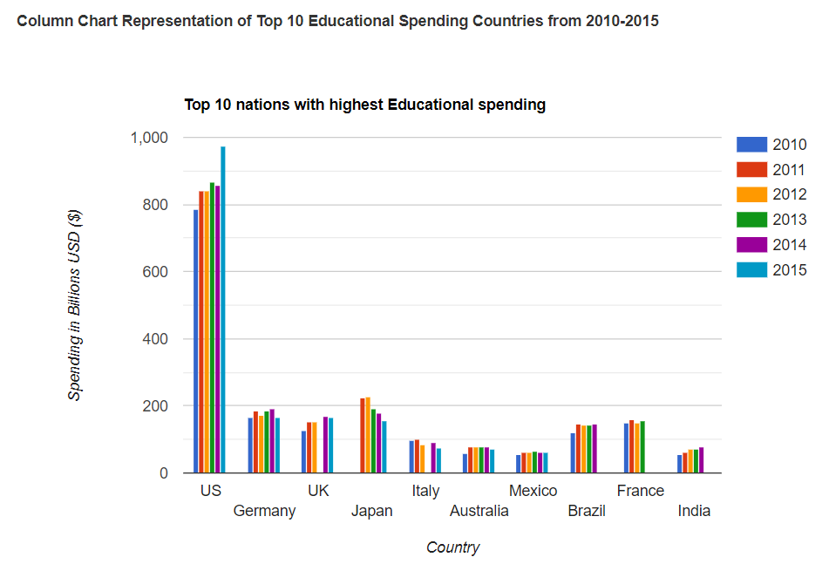
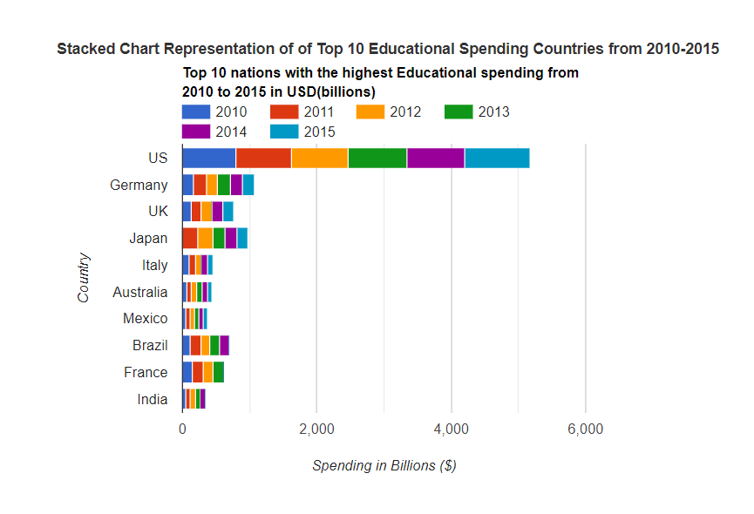
The educational spending of top 10 nations

Slide 5
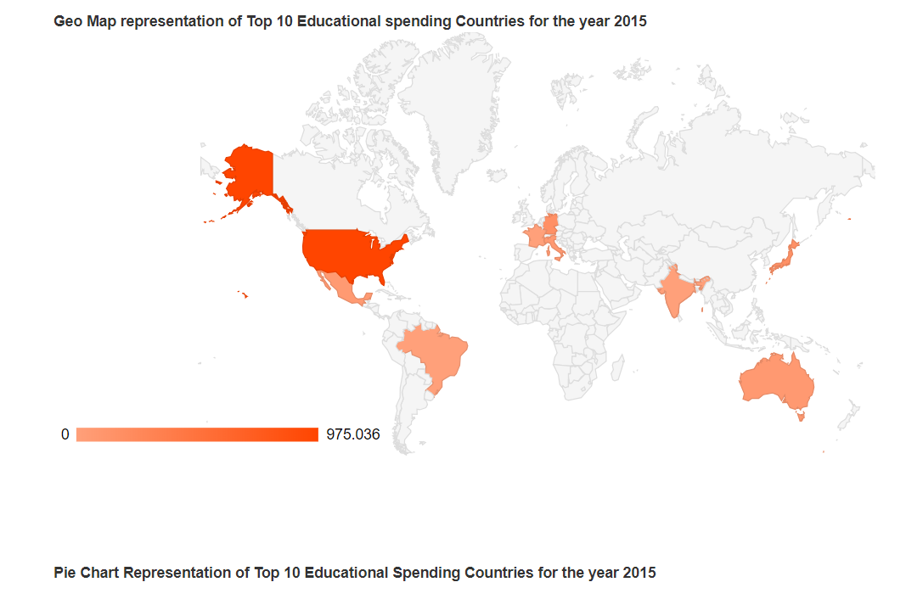
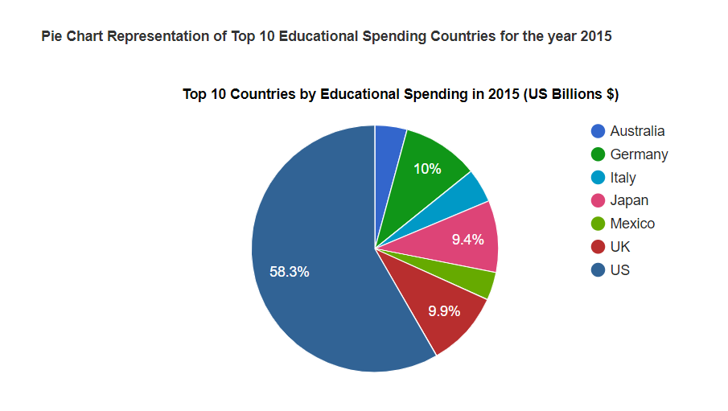
The educational spending of top 10 nations

Slide 6
Healthcare spending trend
The following chart shows the trend of healthcare spending in USA seems to be gradually increased from 2010 to 2015 from 2543 billions to 3106 billions.
Japan was in second place from 2010-2012 but China seems to be leading from 2012-2015.
Russia is the least spending country.

Slide 7
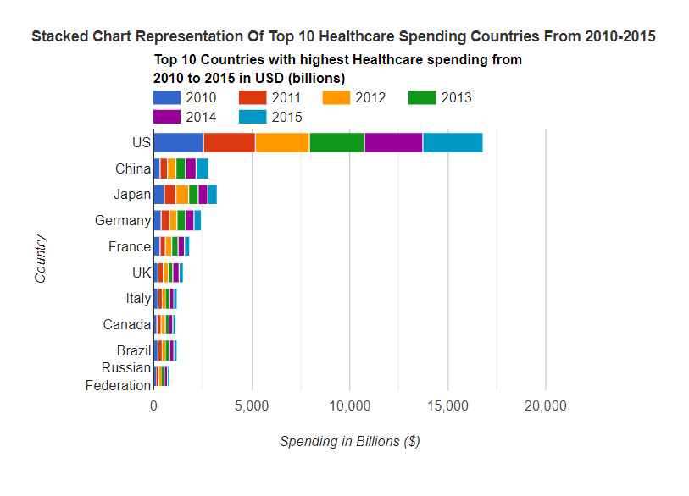
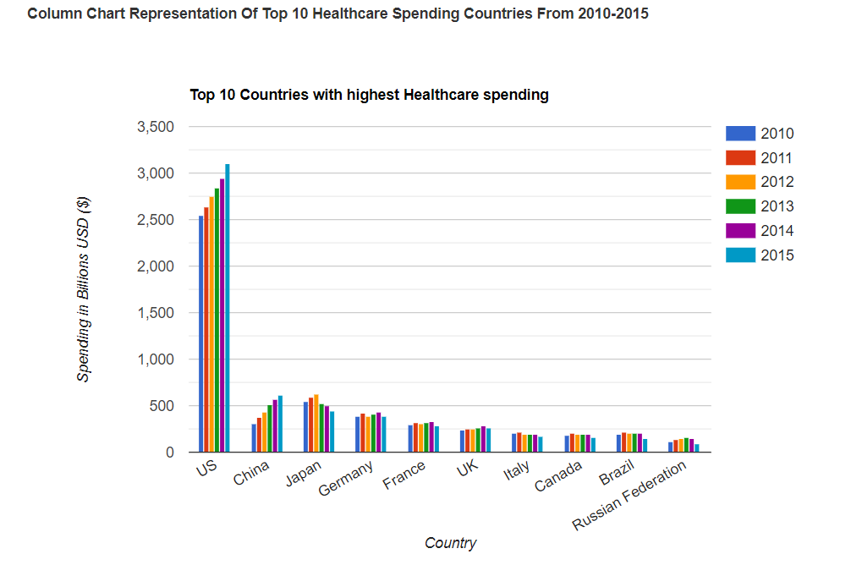
The Healthcare Spending Of The Top 10 Nations

Slide 8
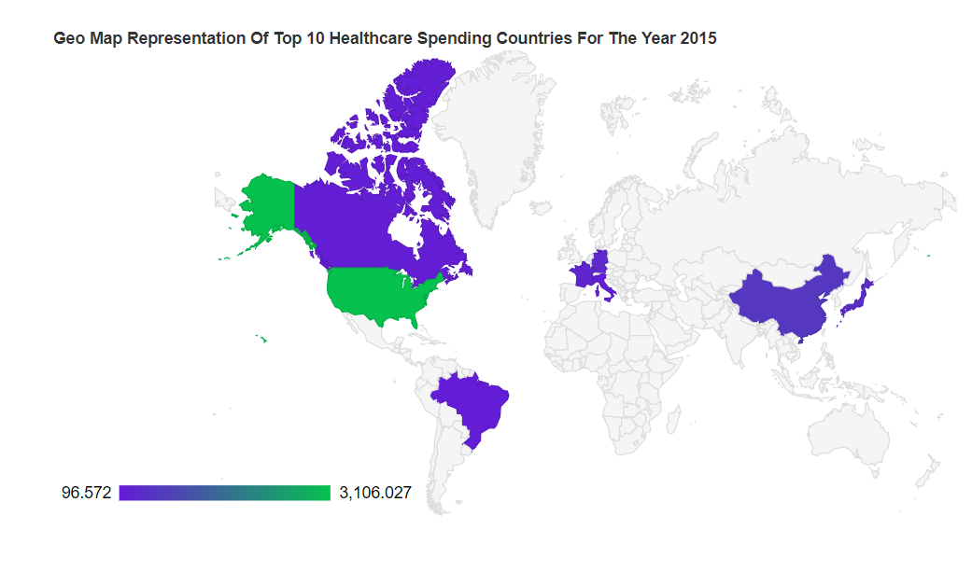
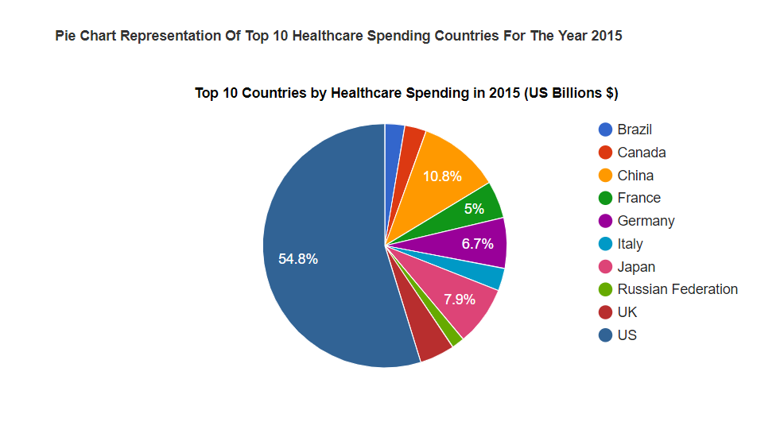
The Healthcare Spending Of The Top 10 Nations

Slide 9
Military spending trend
The following chart shows the trend of Military spending in USA seems to be gradually increased from 2010 to 2012 from 724 billions to 740 billions and then started to decrease from 2013 to 2015.
China seems to be in second place
Italy is the least spending country in terms of military.

Slide 10
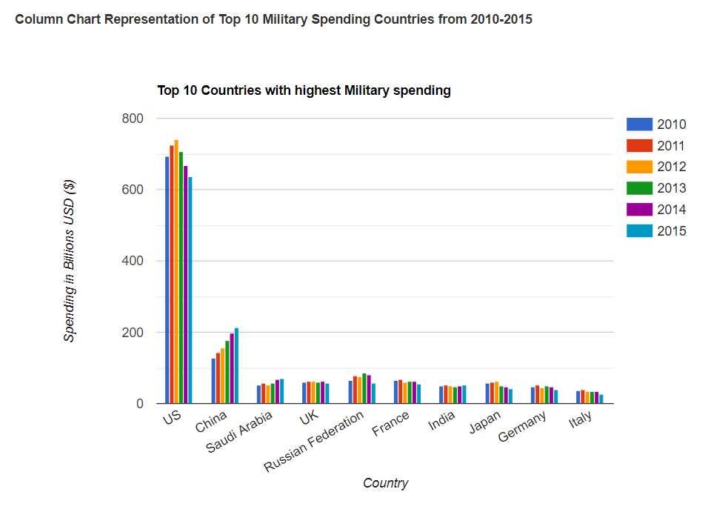
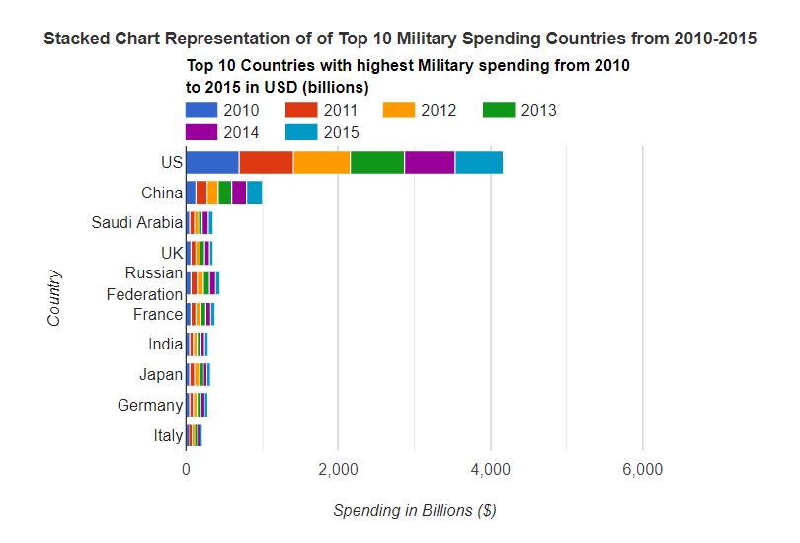
The military spending of top 10 nations

Slide 11
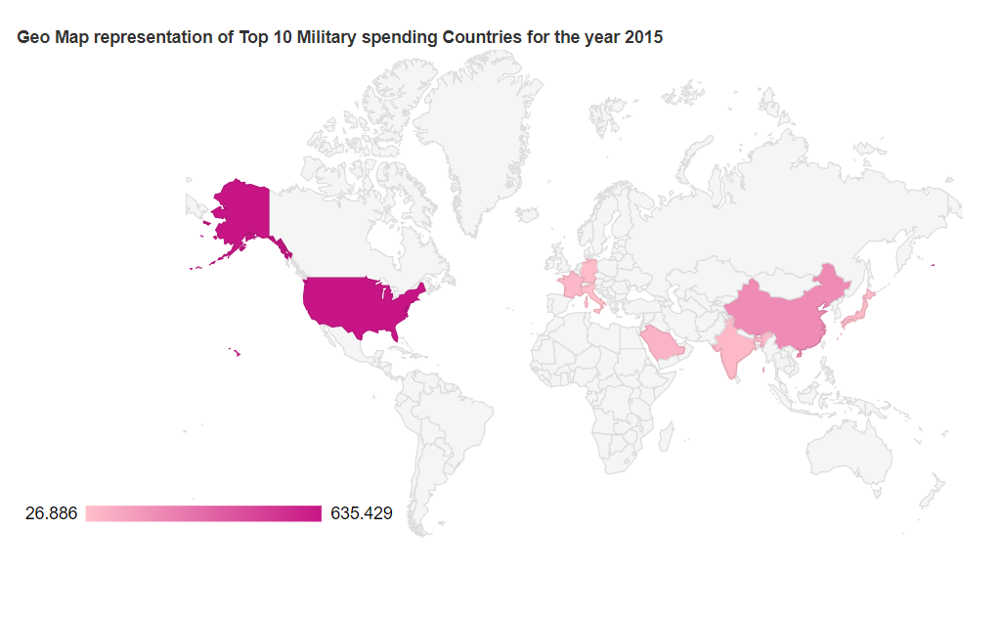
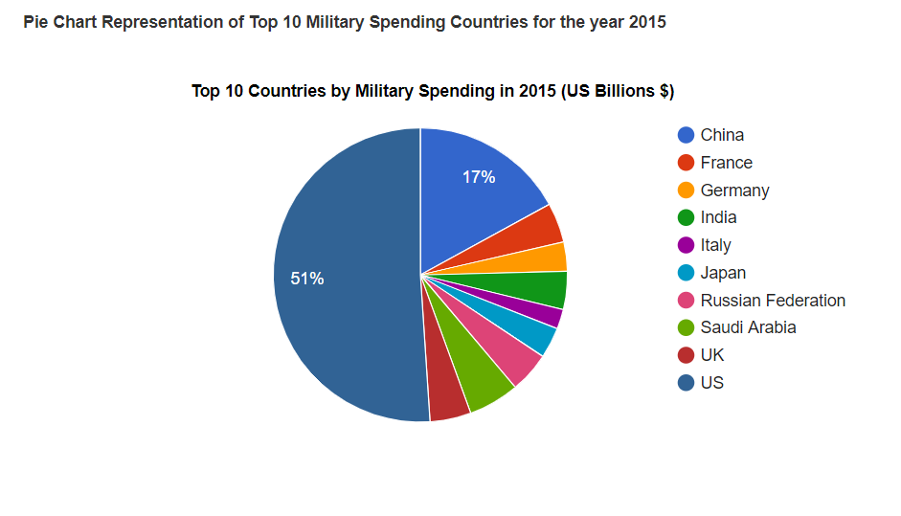
The Military spending of top 10 nations

Slide 12
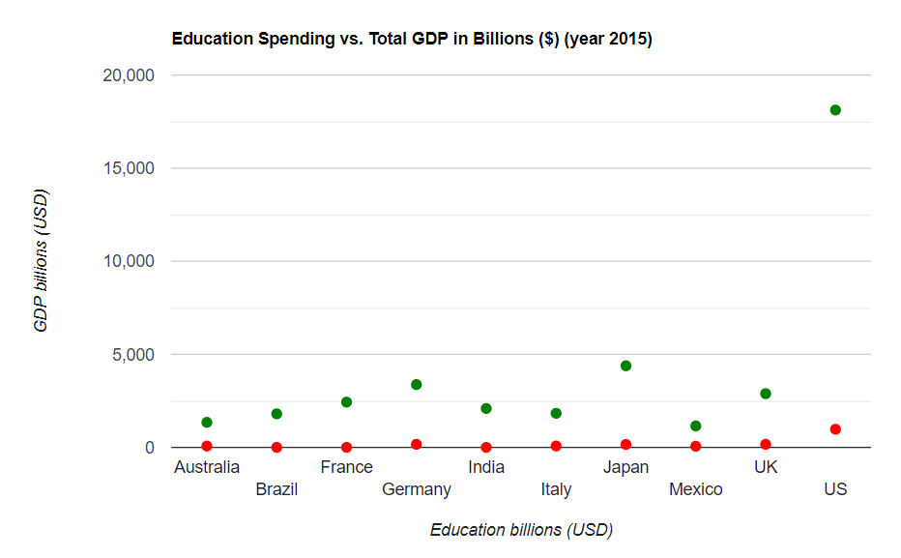
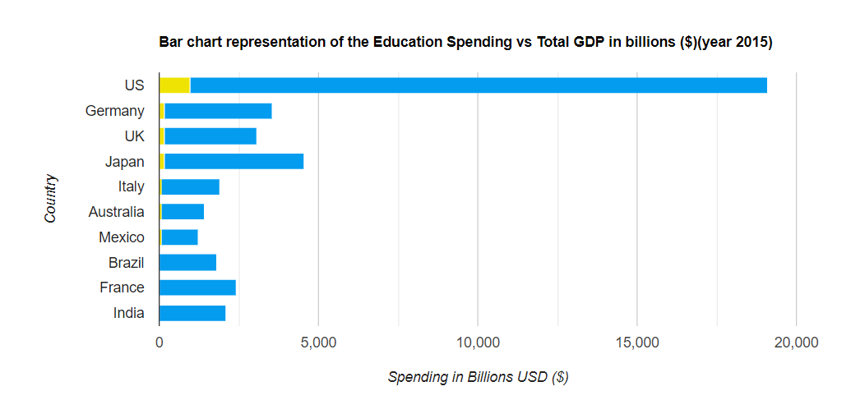
Compare The Spending Data To That Country’s GDP

Slide 13
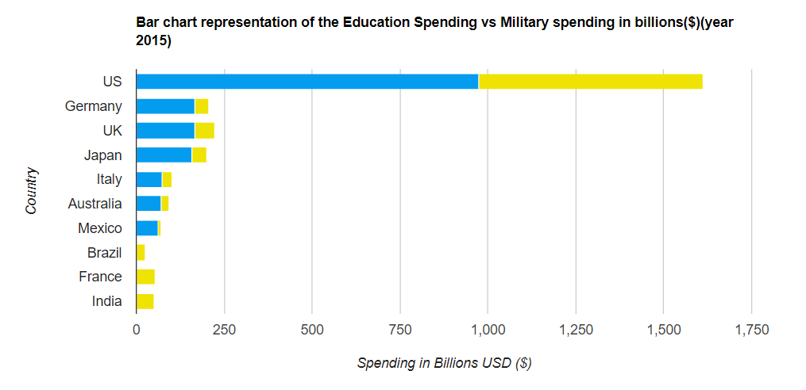
Compare Education Spending To The Overall Military Spending Of That Country

Slide 14
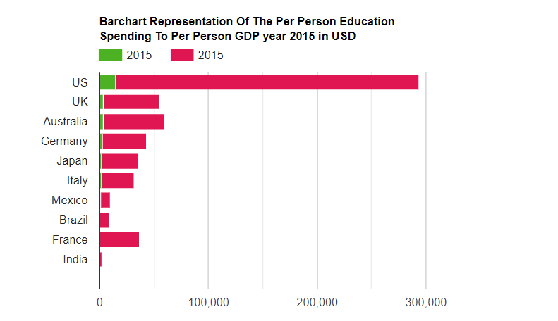
Compare The Per Person Education Spending To Per Person GDP

Slide 15
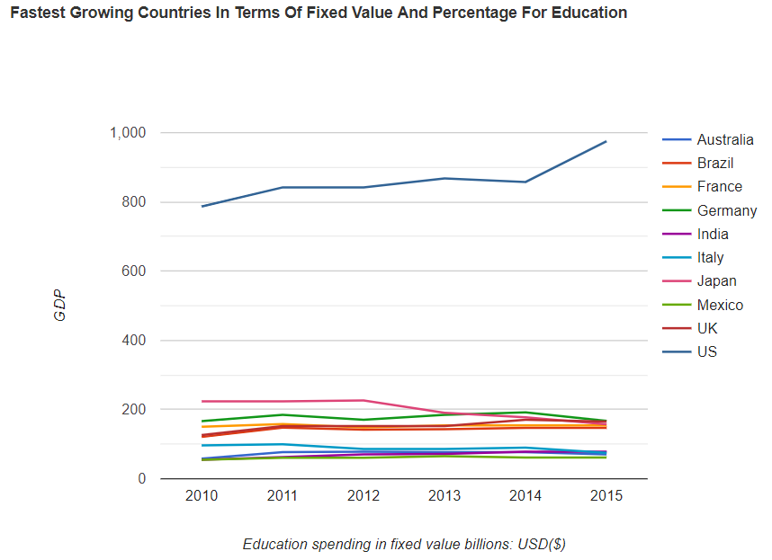
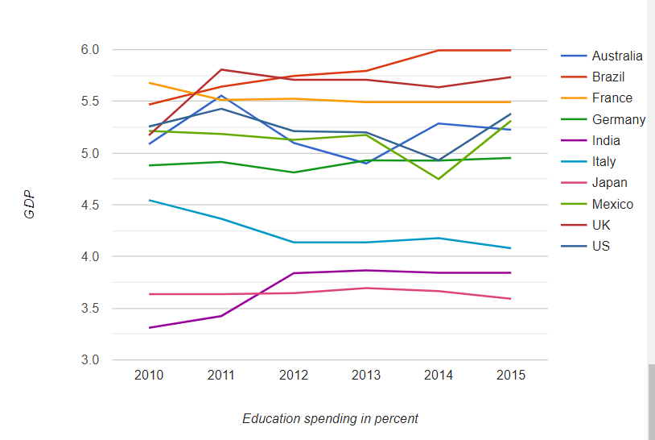
Single Out The Fastest Growing Countries In Education Spending In Fixed Value And Percentage

Slide 16
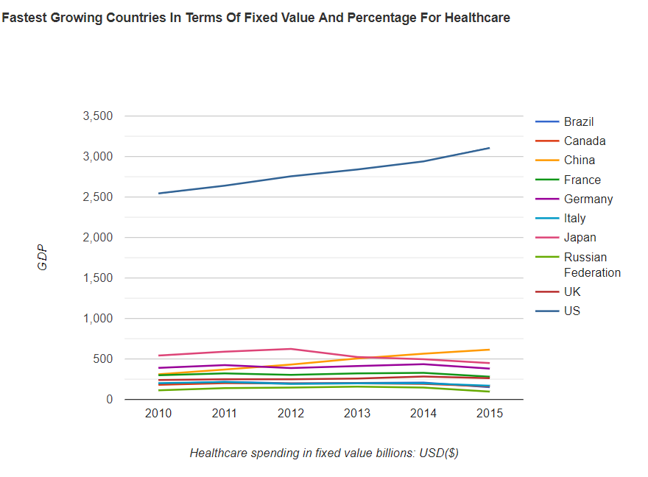
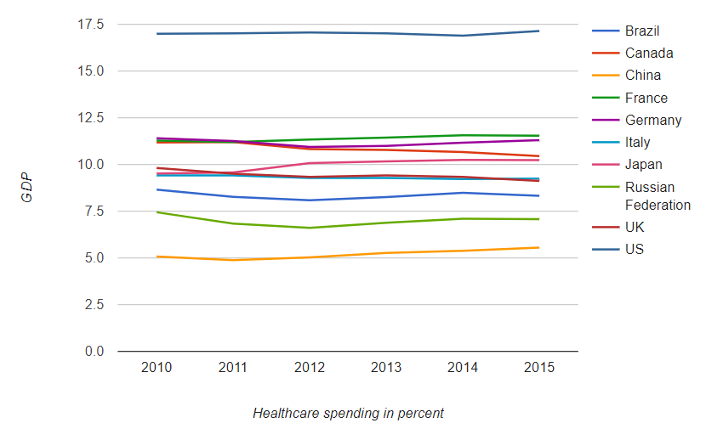
Single Out The Fastest Growing Countries In Healthcare Spending In Fixed Value And Percentage

Slide 17
CONCLUSION
USA ranks the highest in GDP (16,473 Billion US Dollars), Education Spending(975 billions $), Healthcare (3106 Billion US Dollars) Spending and Military Spending(635 Billion US Dollars)
In terms of percent spending on Education Brazil ranks the highest, that is 5.99 percent of the total GDP
In terms of percent spending on Healthcare USA ranks the highest, that is 17.1 percent of the total GDP

